Slide 1

NYC Building Permits
Implementation of Deep Learning in Real Settings
Deep Dive 4
Burzin Wadia [ Burzin Wadia | LinkedIn ]
Mandar Parkar [Mandar Parkar | LinkedIn ]
Tian Sun [ Tian Sun | LinkedIn ]
Zhicheng Tang [ Zhicheng Tang | LinkedIn ]

Slide 2


Introduction
Objective
Develop an RNN-based predictive model for anticipating building permit types, supporting optimal location decisions and temporal interdependency understanding
Problem Statement
Possible Solution
By deploying an RNN, our goal is to provide stakeholders with predictive insights into NYC's building permit landscape, facilitating strategic urban development decisions.
Predicting NYC building permits, with diverse types and geographic nuances, poses challenges for strategic decision-making by business owners
Industrial Engineering/ME434 Deep Learning Maths. Contributors: Mandar Parkar, Zhicheng Tang, Tian Sun, Burzin Wadia

Slide 3




Data Source
Data Source Description
The "DOB Permit Issuance" dataset, managed by NYC's Department of Buildings (DOB), records permits issued since 1989. Updated daily, it covers construction and demolition details, falling under Housing & Development. Valuable for urban planning and regulatory compliance, it serves stakeholders involved in NYC's development landscape
Data Collection Method
Data is collected daily through permit applications from the construction industry to the DOB, representing unique permit applications with job specifics, permit types, and geographical coordinates, reflecting NYC's dynamic construction landscape.
Usage and Limitations
The dataset predicts NYC building permits, aiding in location decisions and temporal understanding. With historical permit records, it enables trend analysis. Users should note variations in permit statuses (e.g., IN PROCESS, ISSUED) and diverse work types
Column Information
The dataset features key details like BOROUGH, Job Type, Permit Type, and Issuance Date, offering insights into location, work nature, and permit status. It also provides geographical information like Latitude, Longitude, Council District, and Census Tract
Industrial Engineering/ME434 Deep Learning Maths. Contributors: Mandar Parkar, Zhicheng Tang, Tian Sun, Burzin Wadia

Slide 4
Data Preprocessing
Feature Selection
Selected features, including borough, job details, location, work and building types, owner's business specifics, non-profit status, coordinates, council district, and important dates, meet project requirements.
Data Types and Missing Values
The data types of each column are checked using df.info(). Categorical columns are identified and converted to the 'category' data type. The presence of missing values in each column is assessed using df.isna().sum()’
Data Cleaning
Rows with missing values are dropped using df.dropna(inplace=True), and the index is reset. This step is taken to ensure data integrity and consistency
Conversion of Data Types
Certain columns, such as 'block', 'lot', and 'zip_code', are converted to numeric types using pd.to_numeric with the 'coerce' option, which converts non-numeric values to NaN
Data Loading
The data preprocessing starts by loading information from a serialized pickle file using the pd.read_pickle function from the pandas library.
Further Data Cleaning
Rows with non-numeric values in 'block', 'lot', and 'zip_code' are dropped using df.dropna(subset=['block', 'lot', 'zip_code'], how='any’)
Feature Engineering
Additional features are created from the 'issuance_date' and 'job_start_date', including 'issuance_year', 'issuance_month', 'issuance_day', 'job_start_year', 'job_start_month', and 'job_start_day'
Statistical Description
Descriptive statistics such as mean, min, max, and quartiles are computed for numerical columns using df.describe()
Exploratory Data Analysis
The counts of categorical features like 'permit_type', 'borough', 'job_type', 'work_type', etc., are examined and visualized through bar charts to gain insights into the distribution of value
Correlation Analysis
A correlation matrix is generated to explore the relationships between different columns in the dataset. This is done by converting categorical variables to numerical using pd.factorize
Industrial Engineering/ME434 Deep Learning Maths. Contributors: Mandar Parkar, Zhicheng Tang, Tian Sun, Burzin Wadia

Slide 5
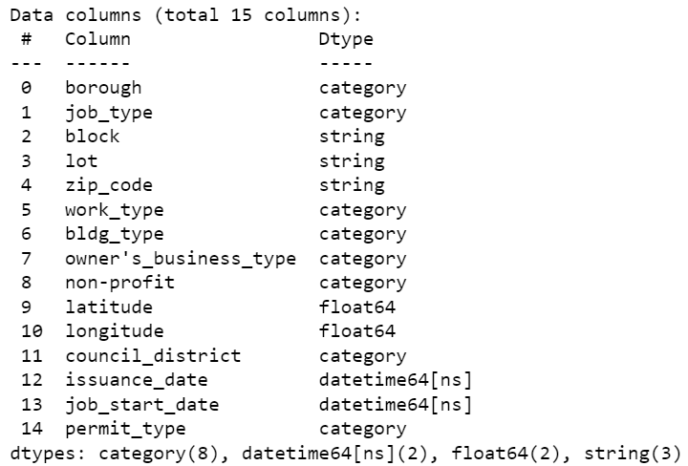
Dataset Overview
The original dataset comprised 60 columns. Some useless features contain over half of the missing values or have significantly high dimensional categorical data.
The refined training dataset was distilled to 14 features, with the 'Permit Type' column designated as the target variable for modeling purposes.
Fig 1 : Data Columns and its Data Types
Industrial Engineering/ME434 Deep Learning Maths. Contributors: Mandar Parkar, Zhicheng Tang, Tian Sun, Burzin Wadia

Slide 6
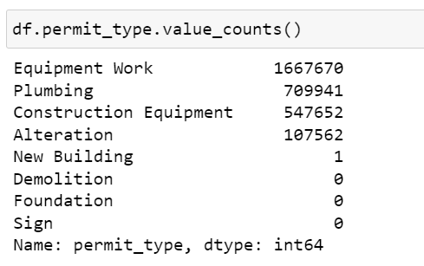
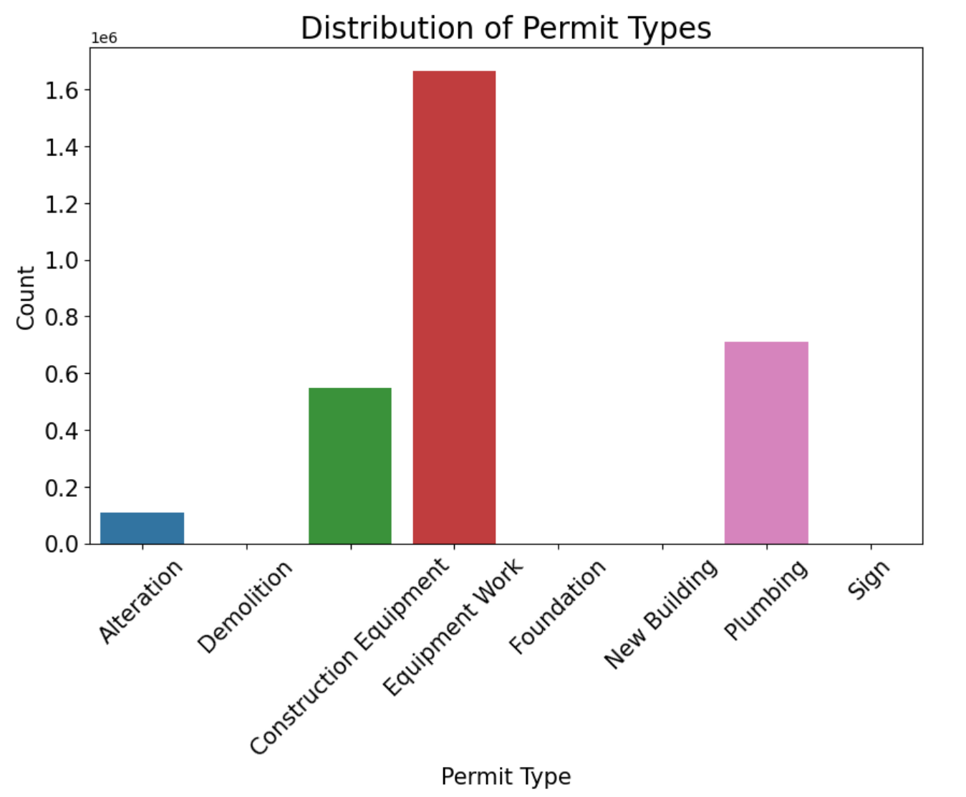
Exploratory Data Analysis
Bias in Label Values:
There exists significant bias among the label values.
Considered Method:
Over-sampling was considered as a method to address the bias.
Impracticality:
Over-sampling was deemed impractical due to the need to over-sample low-frequency data by a factor of 10.
Many categories had no records, further complicating the over-sampling approach.
Fig 2 : Frequency Distribution of Permit Type Categories
Industrial Engineering/ME434 Deep Learning Maths. Contributors: Mandar Parkar, Zhicheng Tang, Tian Sun, Burzin Wadia

Slide 7
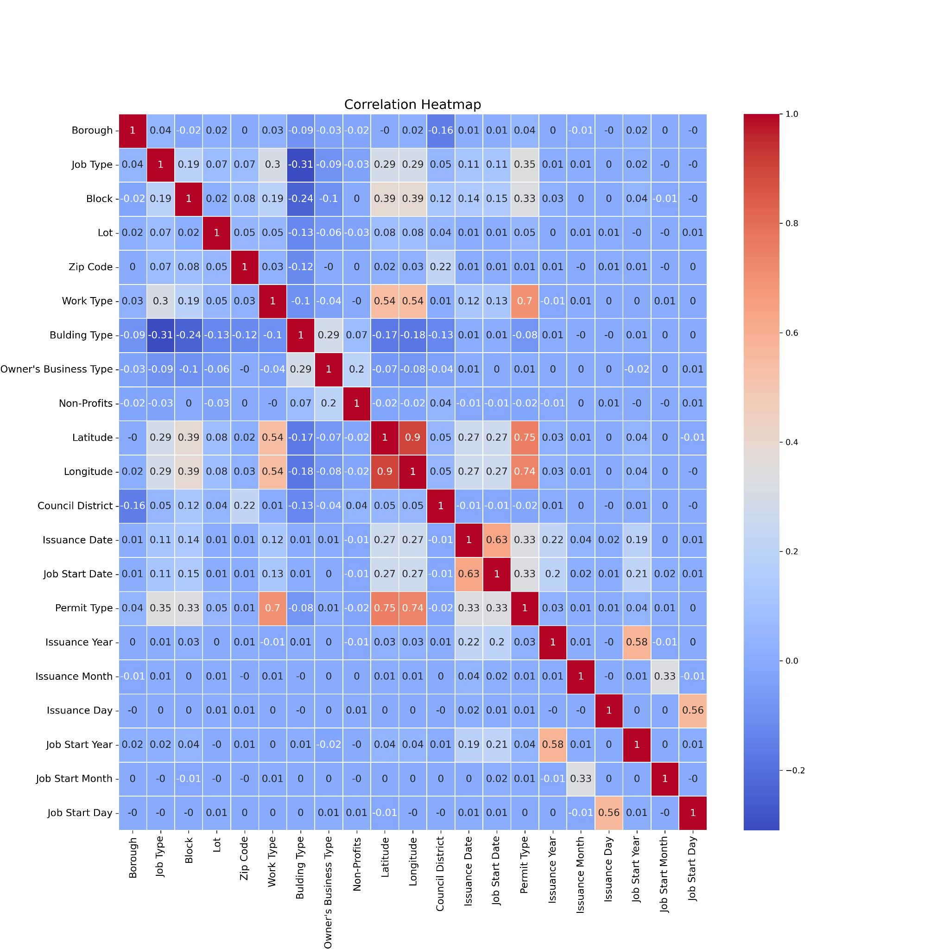
Heat Map
Correlation Observation:
Minimal correlation is observed among the feature variables.
Desirable Characteristic:
This lack of strong correlation is considered desirable for our baseline model.
Fig 3: Correlation Matrix Heatmap
Industrial Engineering/ME434 Deep Learning Maths. Contributors: Mandar Parkar, Zhicheng Tang, Tian Sun, Burzin Wadia

Slide 8
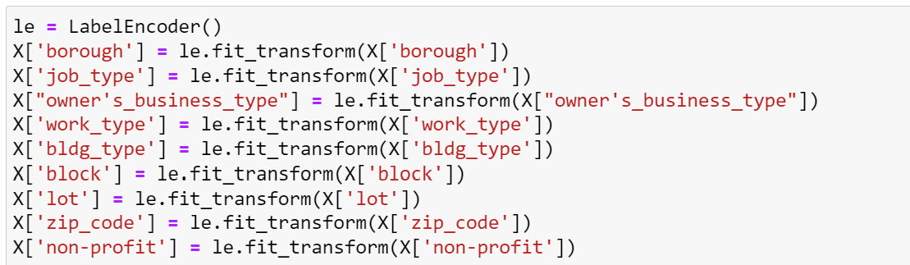
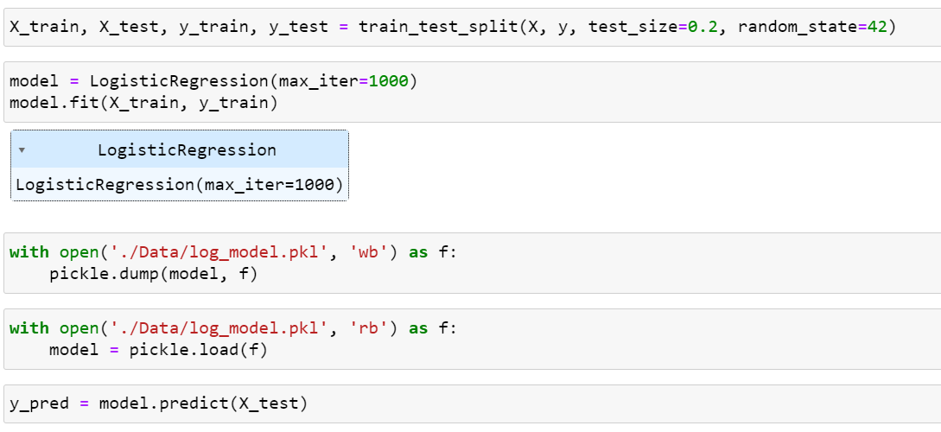
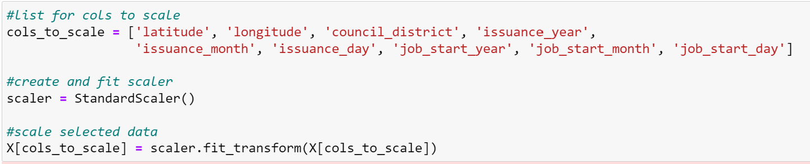
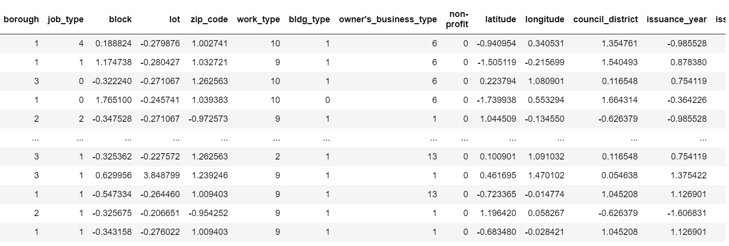
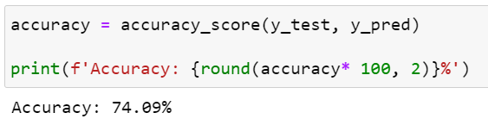
Logistic Regression
Label Encoding
Data Split and Model Training
Standard Scaling
Scaled and Encoded Data
Performance Metrics
Industrial Engineering/ME434 Deep Learning Maths. Contributors: Mandar Parkar, Zhicheng Tang, Tian Sun, Burzin Wadia

Slide 9
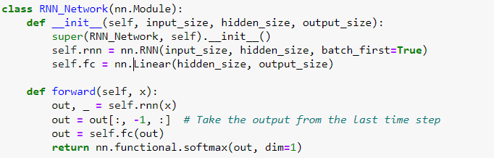
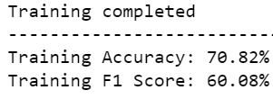
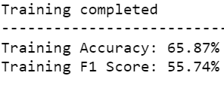
Deep Learning Model
Model and Neural Network Architecture
Effects of Mini-Batch
Learning
Effects of Different
Optimizers
FNN Model as Benchmark
We first use a Fully Connected Neural Network (FNN) as the benchmark of our deep learning model.
Flexible RNN Architecture:
Further employs a Recurrent Neural Network (RNN) with adjustable input and hidden sizes.
Sequential Information Capture:
RNN processes input sequences over time steps, capturing dependencies.
Efficient Output Selection:
Extracts output from the last time step for relevant information.
Classification Capability:
Fully connected layer maps RNN output to desired class size using softmax for multi-class classification. Eventually achieves a better accuracy than FNN.
The RNN model achieves around 71% accuracy (Adam) and 66%(SGD), which is slightly lower than the logistic regression baseline model.
BN-equipped RNN model with a batch size of 64 achieves 75.74% accuracy.
Enhances convergence and overall performance in deep learning models, highlighting robustness.
Minimal performance difference observed between Adam and SGD optimizers on RNN model.
Similar accuracy and loss values on the test set.
Suggests optimizer choice may not significantly impact model convergence or generalization.
Recommends further investigation into hyperparameter tuning or alternative optimizers for nuanced effects.
Fig 5: Recurrent Neural Network (RNN)
Fig 6: Optimizers: Adam vs SGD
Industrial Engineering/ME434 Deep Learning Maths. Contributors: Mandar Parkar, Zhicheng Tang, Tian Sun, Burzin Wadia

Slide 10
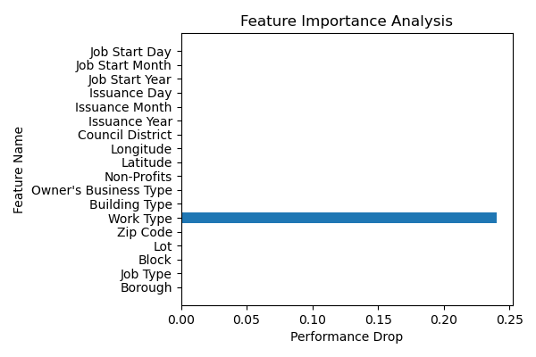
Feature Importance Analysis
Procedures
Model Fitting:
Split data into train and test set. Fit the model using train set. Then, validate the model accuracy on the original test set as a benchmark.
Shuffling Procedures:
Randomly shuffle values of each feature individually on the test dataset.
Performance Measurement:
Validate the model accuracy on the shuffled test set and compare with the benchmark. Significant performance drop indicates that feature is important.
Results
Plot Description:
Y-axis: Indicates performance drop after shuffling features.
X-axis: Represents feature index.
Key Insight:
Feature “Work Type” emerges is the most crucial, with a substantial 25% drop in test performance when values are shuffled.
Fig 7: Feature Importance
Industrial Engineering/ME434 Deep Learning Maths. Contributors: Mandar Parkar, Zhicheng Tang, Tian Sun, Burzin Wadia

Slide 11
Conclusion
Comparing to our baseline Logistic Regression model which has an accuracy of 74.09%, our RNN model with a batch size of 64 achieves 75.54% accuracy.
Adam optimizer achieves a better accuracy as 71% than SGD does with a 66%.
According to our model, among the 14 features we use to predict the permit type, “Work Type” is the most significant feature.
Industrial Engineering/ME434 Deep Learning Maths. Contributors: Mandar Parkar, Zhicheng Tang, Tian Sun, Burzin Wadia

Slide 12
References
DOB Permit issuance | NYC Open Data. (2023, December 9).
https://data.cityofnewyork.us/Housing-Development/DOB-Permit-Issuance/ipu4-2q9a
Working with RNNs. (n.d.). TensorFlow.
https://www.tensorflow.org/guide/keras/working_with_rnns
How to determine feature importance in a neural network? (n.d.). Data Science Stack Exchange. https://datascience.stackexchange.com/questions/44644/how-to-determine-feature-importance-in-a-neural-network
Industrial Engineering/ME434 Deep Learning Maths. Contributors: Mandar Parkar, Zhicheng Tang, Tian Sun, Burzin Wadia

Slide 13
Thank You
Industrial Engineering/ME434 Deep Learning Maths. Contributors: Mandar Parkar, Zhicheng Tang, Tian Sun, Burzin Wadia

